Slide 1

Ride-Sharing Analytics Platform
Sec - 04
TEAM NO : 20
2420090101 – N DhanuSree
2420090032 - Y Viditha
2420030678 – G GopiKrishna
Under the guidance of
Dr. NALLA SIRISHA
Associate Professor
Department of Computer Science and Engineering
Koneru Lakshmaiah Education Foundation
(Deemed to be University estd. u/s. 3 of the UGC Act, 1956)
Off-Campus: Bachupally-Gandimaisamma Road, Bowrampet, Hyderabad, Telangana - 500 043.
Phone No: 7815926816, www.klh.edu.in

Slide 2
Table of Contents
Abstract
Introduction
Objectives
Existing System
Limitations of Existing System
Proposed System
Literature Survey
Software Requirements
Hardware Requirements
Functional Requirements
Non-Functional Requirements
System architecture
UML Diagrams
Methodology
Technologies Used
Implementation
Functionality / Flow Diagram
Results
Comparison
Conclusion
References

Slide 3

Abstract
The rapid growth of ride-sharing platforms like Uber has made data-driven decision-making essential for improving service efficiency and customer experience in urban transportation. This project, "Ride-Sharing Analytics Platform," proposes an Uber-like system that stores trip information, calculates peak traffic hours, tracks driver performance, and predicts future ride demand. The platform is built using Python for data processing, PostgreSQL for structured storage, Apache Kafka for real-time streaming, Apache Airflow for ETL pipeline orchestration, Docker for containerized deployment, and Power BI for interactive dashboard visualization. By automating data collection and transformation through scalable ETL pipelines, the system delivers actionable insights on demand patterns, traffic trends, and driver performance, supporting better fleet management and pricing decisions. Through this project, practical skills are gained in ETL pipeline development, database management, data warehousing, and dashboard design — key competencies for real-world data engineering roles.

Slide 4

Introduction
The emergence of ride-sharing platforms has significantly reshaped urban mobility, offering passengers a convenient, technology-driven alternative to traditional modes of transportation.
These platforms generate massive volumes of data daily — including trip requests, real-time driver locations, fare details, and user behavior patterns — making efficient data analysis critical for service improvement.
Despite this abundance of data, many platforms lack a structured analytical framework to convert raw data into actionable business insights.
Common operational challenges include inconsistent driver availability during peak hours, inefficient route allocation, and unpredictable fare surges, all of which affect customer satisfaction and platform reliability.
This project addresses these challenges by developing a Ride-Sharing Analytics Platform that processes trip data through automated pipelines to generate insights on demand, traffic, and driver performance.
The system leverages modern data engineering tools to deliver a scalable, real-time analytics solution that supports informed, data-driven decision-making

Slide 5
Objectives
To design and develop a data analytics platform that stores comprehensive ride-sharing trip information (pickup/drop location, fare, duration)
To calculate and visualize peak traffic hours across different zones for better fleet planning
To build a module for tracking and evaluating individual driver performance
To implement a predictive model that forecasts future ride demand using historical data
To build automated ETL pipelines using Apache Airflow for reliable, scheduled data processing
To enable real-time data ingestion using Apache Kafka for continuous trip event streaming
To containerize the entire application using Docker for consistent, scalable deployment
To present all insights through an interactive Power BI dashboard for data-driven decision-making

Slide 6
Existing System
Existing ride-sharing platforms collect trip, driver, fare, and user-related data.
Data is generally stored across different systems and databases.
Analysis is mainly performed on previously collected trip data.
Peak traffic and ride-demand patterns are identified from historical data.
Driver performance is evaluated using available trip information.
Data processing may involve separate tools for storage, processing, and visualization.
Real-time streaming and automated ETL are not fully integrated into a single analytical workflow.

Slide 7
Limitations of Existing System
Delayed Data Analysis: Insights may not be available immediately when new trip data arrives.
Demand Uncertainty: Sudden changes in ride demand are difficult to identify.
Driver Availability: Maintaining sufficient drivers during peak hours can be challenging.
Inefficient Fleet Planning: Lack of timely insights can affect driver and vehicle allocation.
Fare Surge Challenges: Sudden demand variations can result in unpredictable fare changes.
Data Silos: Data from different sources may be difficult to integrate.
Limited Automation: Manual data processing can increase processing time.
Scalability Issues: Handling continuously increasing ride data can become difficult.

Slide 8
Proposed System
Develop a Ride-Sharing Analytics Platform for centralized ride-data analysis.
Store trip, driver, and payment data in PostgreSQL.
Use Apache Kafka for real-time trip-event streaming.
Use Apache Airflow to automate ETL pipelines.
Use Python for data processing and demand prediction.
Analyze peak hours, traffic patterns, demand trends, and driver performance.
Use Power BI for interactive visualization and dashboards.
Use Docker for containerized and scalable deployment.
Provide data-driven insights for better fleet management and decision-making.

Slide 9
Literature Survey
S.No | Research paper | Author(s) | Link | Drawback
1. | Short-term prediction of demand for ride-hailing services: A deep learning approach (UberNet) | Long Chen et al. | https://arxiv.org/abs/2212.03956 | Trained on NYC-specific data; may not generalize well to other cities with different traffic patterns
2. | Analysis and prediction of New York City taxi and Uber demands | (NYC study, published in scielo.org.mx) | scielo.org.mx/scielo.php?script=sci_arttext&pid=S1665-64232023000500886 | Built around NYC's zip-code zones and weather data; not directly applicable to other cities
3. | Ride-hailing fares and demand interactions | (ScienceDirect, 2026) | https://sciencedirect.com/science/article/abs/pii/S0739885926000351 | Focuses only on Uber and Lyft in New York City over a short 15-day window, so findings may not hold for other markets or longer time periods.
4. | Predicting rideshare demand (Public Policy Analytics, Ch. 8) | Ken Steif | https://urbanspatial.github.io/PublicPolicyAnalytics | Notes that spatio-temporal forecasting remains an open research problem, and reactive routing approaches often arrive after a demand spike has already ended.
5. | Modeling and prediction of ride-sharing utilization dynamics | (Hindawi, Journal of Advanced Transportation) | https://hindawi.com/journals/jat/2019/6125798 | The prediction method is validated on a single dataset of NYC taxi trips from a specific month, limiting confidence in broader applicability.
6. | Real-time text analytics pipeline using open-source big data tools | Hassan Nazeer, Waheed Iqbal, Fawaz Bokhari, Faisal Bukhari, Shuja Ur Rehman Baig | https://arxiv.org/pdf/1712.04344 | Evaluated only on Twitter sentiment data at a relatively small scale (under half a million tweets), so scalability to much larger, continuous ride-sharing data streams is not proven.

Slide 10
Software Requirements
Software | Purpose
Python | Data processing and demand prediction
PostgreSQL | Storing trip, driver and payment data
Apache Kafka | Real-time event streaming
Apache Airflow | ETL pipeline orchestration
Docker | Containerized deployment
Power BI | Dashboard and data visualization
Operating System | Windows / Linux

Slide 11
Hardware Requirements
Processor: Intel Core i5 or equivalent
RAM: Minimum 8 GB
Storage: Minimum 256 GB SSD
Network: Stable Internet connection
Display: Standard monitor/display
System: 64-bit computer

Slide 12
Functional Requirements
The system should:
Collect Ride Data
  Capture trip, driver, and payment information.
Store Data
  Store structured information in PostgreSQL.
Stream Real-Time Events
  Send trip events through Apache Kafka.
Process Data
  Clean and transform data using ETL pipelines.
Analyze Ride Data
  Identify peak hours, zones, demand patterns and driver performance.
Predict Ride Demand
  Use historical data to forecast future demand.
Generate Dashboards
  Display analytical results using Power BI.
Support Decision-Making
  Provide insights for fleet management and planning.

Slide 13
Non-Functional Requirements
Scalability: The system should handle increasing ride data volumes.
Performance: Data should be processed efficiently for timely analysis.
Reliability: ETL and streaming pipelines should process data consistently.
Availability: The platform should be available for continuous data processing.
Maintainability: Modular Python components should be easy to maintain.
Security: Ride and user-related data should be stored and processed securely.
Usability: Power BI dashboards should present insights clearly.
Portability: Docker should allow consistent deployment across environments.

Slide 14
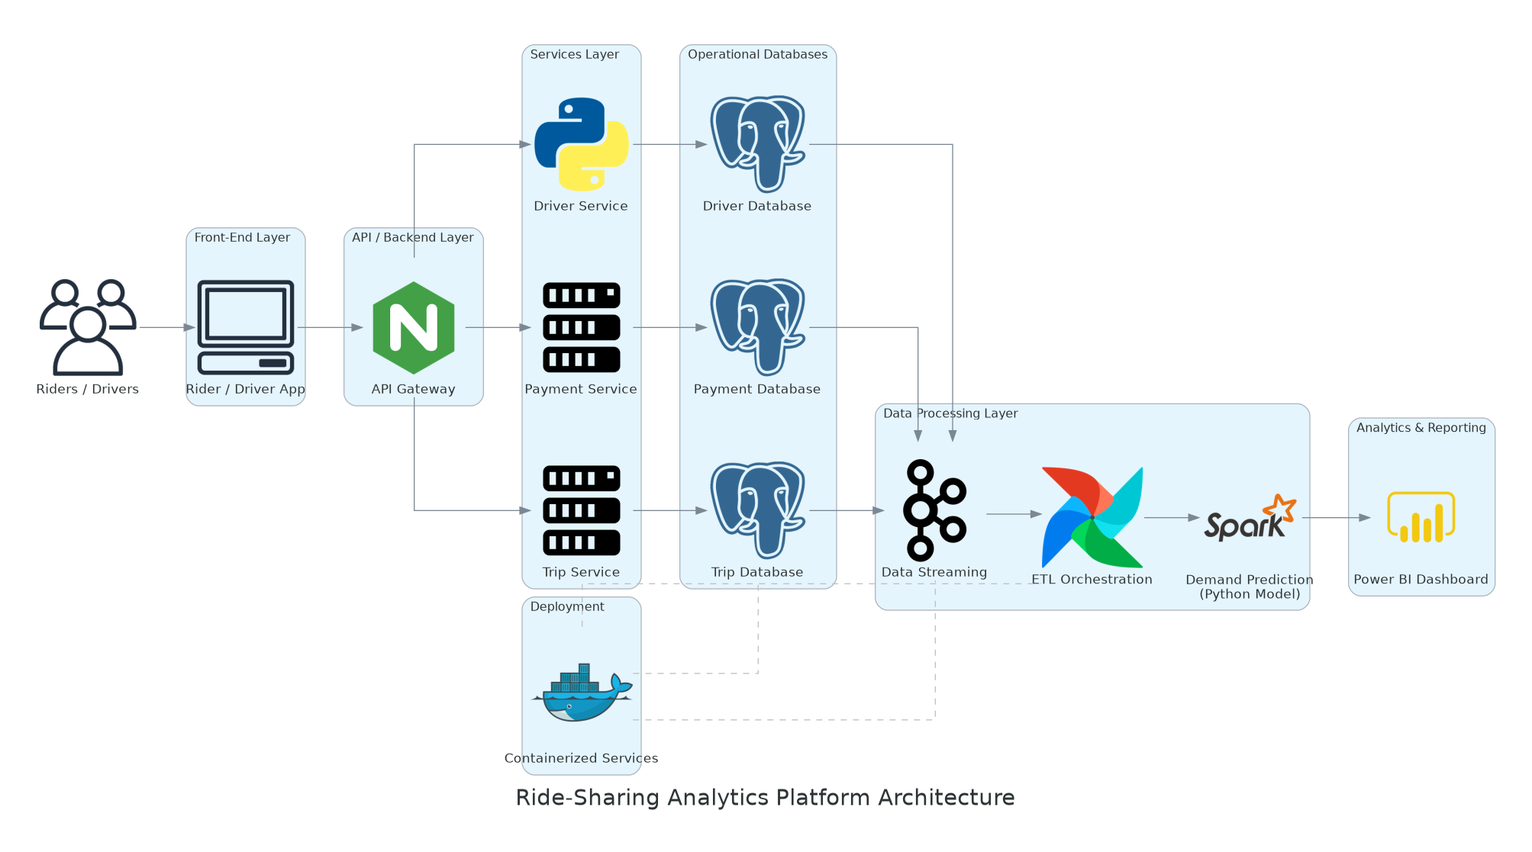
System Architecture

Slide 15
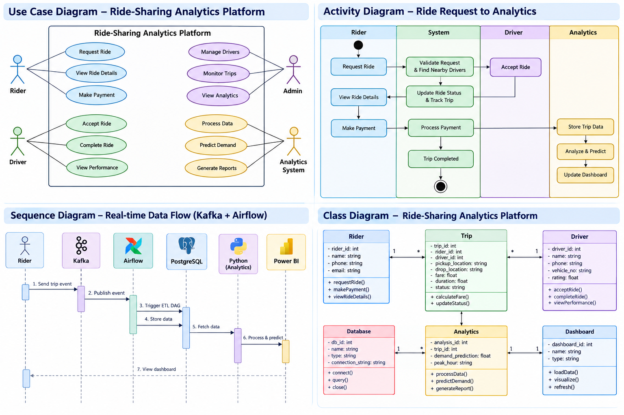
UML Diagrams

Slide 16
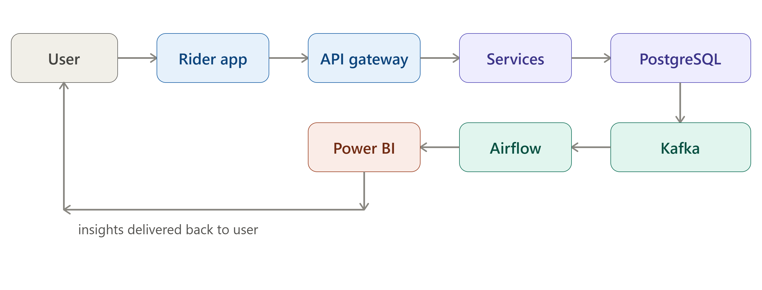
Methodology, System Design and Architecture
Methodology
Collect trip, driver, and payment data from the app
Stream real-time trip events using Kafka
Clean and transform data via automated Airflow pipelines
Analyze traffic, driver performance, and demand trends
Display insights on Power BI dashboards
System Design
Riders/drivers generate trip, driver, and payment events
API Gateway routes requests to backend services
Services store structured data in PostgreSQL
Pipeline streams and transforms data in real time
Analytics engine produces traffic and demand insights

Slide 17
Use of Modern Tools and Technologies
Technologies Used
Processing: Python – data processing and demand prediction logic
Storage: PostgreSQL – structured storage for trip, driver, and payment data
Streaming: Apache Kafka – real-time streaming of trip events
Automation: Apache Airflow – orchestration of automated ETL pipelines
Deployment: Docker – containerized deployment of backend services
Visualization: Power BI – interactive dashboards for insights
These tools are widely used in real-world data engineering roles at companies like Uber, Netflix, and Amazon — reflecting industry-standard practices rather than academic-only methods.
Benefits
Efficient, real-time data processing at scale.
Better analysis of traffic and demand patterns.
Supports accurate driver performance tracking.
Helps improve fleet management and decision-making.

Slide 18
Implementation, Coding Quality and Functionality
Implementation
Build ETL and streaming pipeline
Process trip, driver, and payment data
Analyze peak hours and driver performance
Predict demand using historical data
Display results on Power BI
Coding Quality
Modular Python code (separate extract/transform/load functions)
Clear variable/function naming
Data validation before storage
Independently testable components
Functionality → (insert a similar small flow image: Trip event → Kafka → Airflow → PostgreSQL → Analysis → Power BI, instead of the text sentence)
Real-time trip/driver data collection
Peak zone and hour detection
Driver performance tracking
Better fleet planning

Slide 19
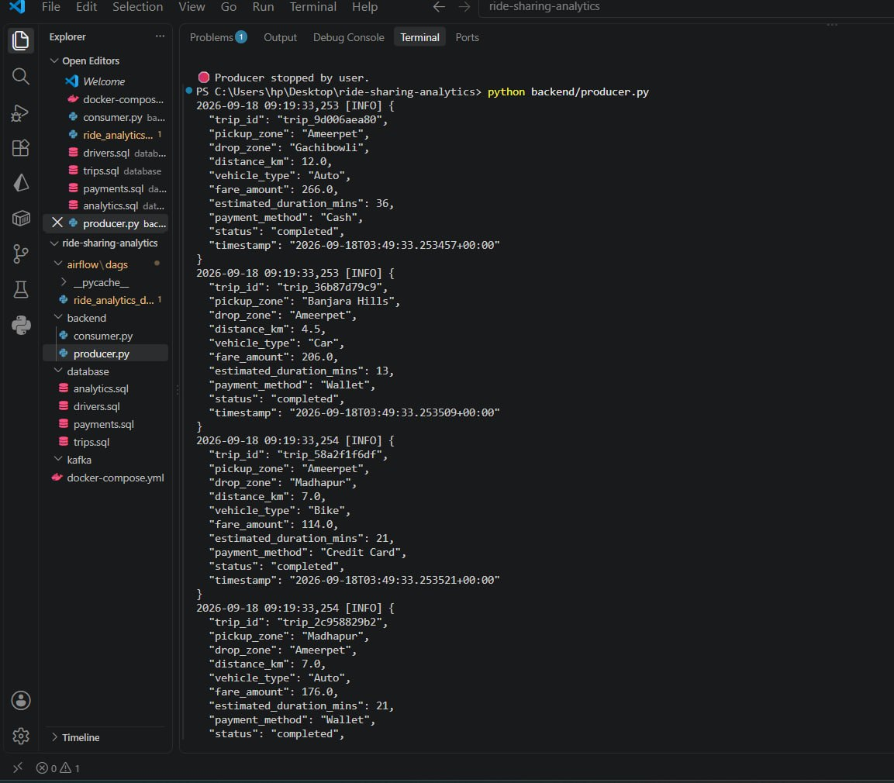
Implementation

Slide 20
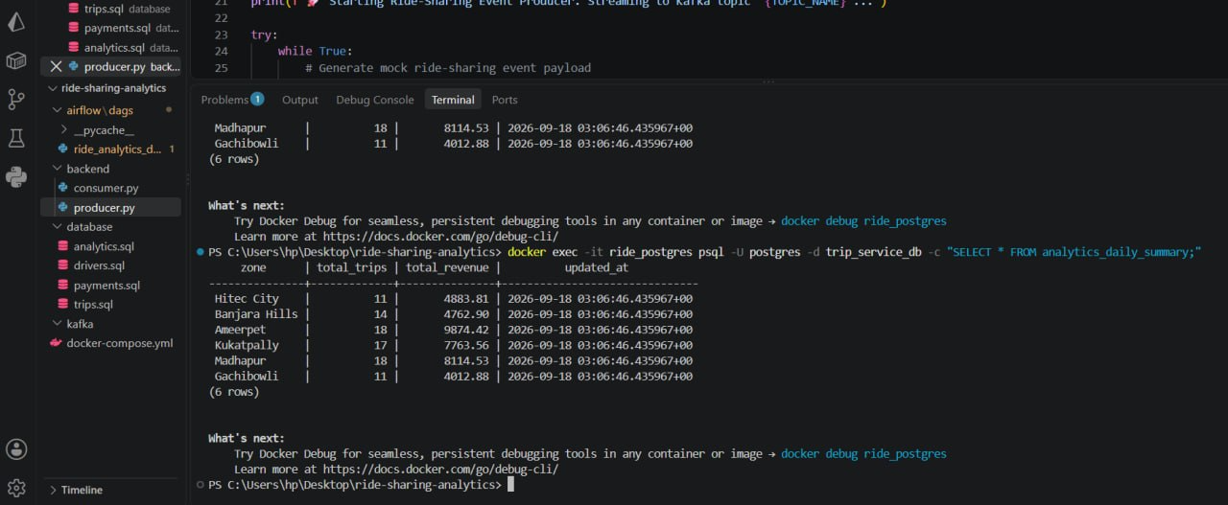
Implementation

Slide 21
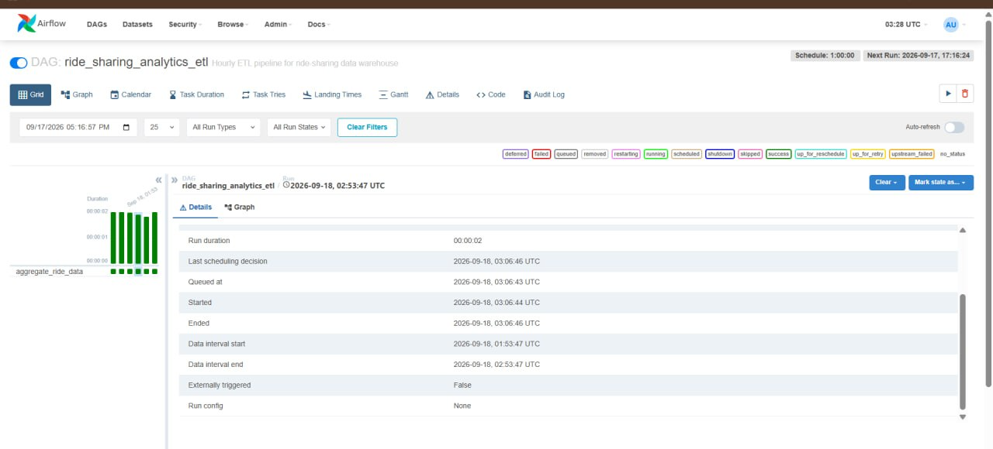
Implementation

Slide 22
Functionality / Flow Diagram

Slide 23
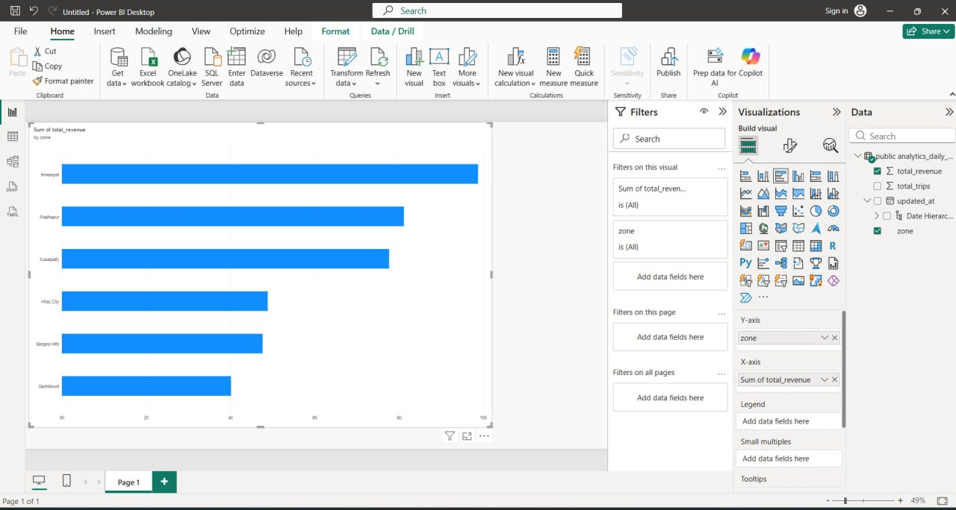
Results
Successfully processes ride-sharing trip data.
Identifies peak traffic hours across different zones.
Provides driver performance insights.
Analyzes ride-demand patterns.
Generates future demand predictions using historical data.
Provides interactive analytical dashboards.
Supports better fleet planning and data-driven decision-making.

Slide 24
Comparison
Feature | Existing System | Proposed System
Data Processing | Mostly historical/batch analysis | Automated processing pipeline
Real-Time Streaming | Limited integration | Apache Kafka
ETL Automation | Limited/manual | Apache Airflow
Data Storage | Multiple/separate systems | PostgreSQL
Demand Analysis | Historical analysis | Historical + prediction
Driver Analysis | Basic monitoring | Performance analytics
Visualization | Limited/varied | Power BI dashboard
Deployment | Traditional deployment | Docker-based deployment
Decision Support | Delayed insights | Data-driven insights

Slide 25
Conclusion
The Ride-Sharing Analytics Platform provides a structured approach to processing and analyzing ride-sharing data.
Kafka enables real-time trip-event streaming.
Airflow automates ETL workflows.
PostgreSQL provides structured data storage.
Python supports data processing and demand prediction.
Power BI provides interactive visualization of analytical insights.
Docker supports consistent and scalable deployment.
The platform helps generate insights into traffic, demand, and driver performance.

Slide 26
References
Use the papers already present in your Literature Survey:
Short-term prediction of demand for ride-hailing services: A deep learning approach (UberNet) — Long Chen et al.
Analysis and prediction of New York City taxi and Uber demands
Ride-hailing fares and demand interactions
Predicting Rideshare Demand — Ken Steif
Modeling and Prediction of Ride-Sharing Utilization Dynamics
Real-time Text Analytics Pipeline Using Open-Source Big Data Tools

